Slide 1

Introduction to neo4J
and Cypher

Slide 2
In this session
We will cover:
Property graph database anatomy
Introduction to Cypher
Continuing your graph journey

Slide 3
So what does a (property) graph look like?

Slide 4
Graph components
Node (Vertex)
The main data element from which graphs are constructed
Jane
car

Slide 5
Graph components
Node (Vertex)
The main data element from which graphs are constructed
Relationship (Edge)
A link between two nodes. Has:
Direction
Type
A node without relationships is permitted. A relationship without nodes is not
Jane
car
OWNS

Slide 6
Property graph database
Node (Vertex)
Relationship (Edge)
OWNS

Slide 7
Property graph database
Node (Vertex)
Relationship (Edge)
Label
Define node category (optional)
:Person
:Car
OWNS

Slide 8
Property graph database
Node (Vertex)
Relationship (Edge)
Label
Define node category (optional)
Can have more than one
:Person
:Car
:Asset
OWNS

Slide 9
Property graph database
Node (Vertex)
Relationship (Edge)
Label
Define node category (optional)
Can have more than one
:Person
:Car
:Asset
OWNS
since: 2018
Properties
Enrich a node or relationship
No need for nulls!
name: Jane
make: Volvo
model: V60

Slide 10
How do I query the graph?

Slide 11
Cypher
Graph databases have their own query language, GQL, an ISO standard for graph databases.
Cypher is Neo4j’s implementation of GQL. Cypher is a declarative language, meaning the database is responsible for finding the most optimal way of executing that query.
11￼

Slide 12
Cypher
Cypher is a declarative query language that allows you to identify patterns in your data using an ASCII-art style syntax consisting of brackets, dashes and arrows
Declarative
Expressive
Pattern Matching
ASCII ART ¯\_(ツ)_/¯
12￼

Slide 13
Node and Patterns
Nodes in the pattern are expressed with parentheses - ( )
Inside the parentheses you can define information about the node, for example the label(s) or properties the node should contain.

Slide 14
Node and Patterns
Relationship information is contained within square brackets -[ ]
The relationship type is prefixed with a colon - [:TYPE]
The pattern contains one relationship -[:ACTED_IN]→ between (:Person) and (:Movie) nodes.

Slide 15
Node and Patterns
The nodes and relationships in the pattern are assigned to variables.
These variables are positioned before the information about the node or relationship.
p - the :Person node
r - the :ACTED_IN relationship
m - the :Movie node

Slide 16
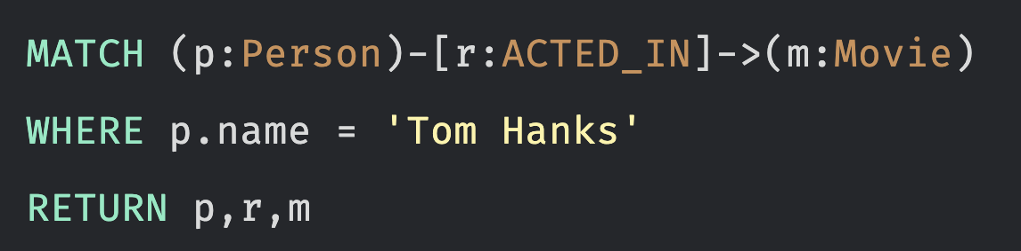
Match - ing
The MATCH clause is used to find patterns in the data.
The pattern being used.
A WHERE clause which filters the results.
The variables used in the RETURN clause.

Slide 17
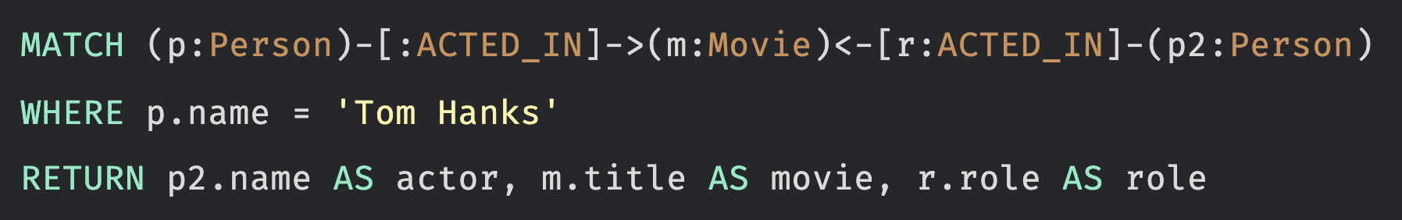
Match - ing
Patterns can be as simple as a single node, or contain multiple relationships.

Slide 18


Match - ing
You can specify a range for filtering a query
There is no requirement that a node or relationship has a given property. This aspect can be used for filtering.

Slide 19


Match - ing
Cypher has a set of string-related keywords that you can use in your WHERE clauses to test string property values. You can specify STARTS WITH, ENDS WITH, and CONTAINS

Slide 20


Match - ing
You can place them in a list or you can test with an existing list in the graph. A Cypher list is a comma-separated set of values within square brackets.

Slide 21


Properties in the graph
The properties for a node with a given label need not be the same. One way you can discover the properties for a node is to use the keys() function
More generally, you can run this code to return all the property keys defined in the graph.

Slide 22

Create Data
To create nodes and relationships in the database, use the MERGE clause.
The MERGE clause creates a pattern in the database.
MERGE will only create the pattern if it doesn’t already exist.

Slide 23

Create Data
To create nodes and relationships in the database, use the MERGE clause.
The MERGE clause creates a pattern in the database.
MERGE will only create the pattern if it doesn’t already exist.

Slide 24

Create Data
To create nodes and relationships in the database, use the MERGE clause.
The MERGE clause creates a pattern in the database.
MERGE will only create the pattern if it doesn’t already exist.

Slide 25
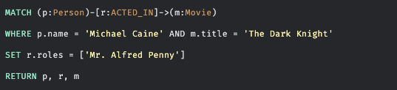
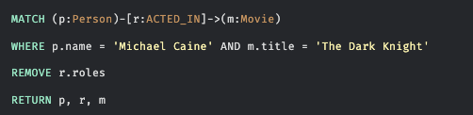
SET Property

Slide 26
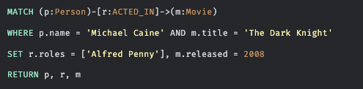
UPDATE and DELETE Property
We also have the option to use the SET keyword for setting a property value. In the context of particular MERGE or MATCH clause where you have defined a variable to reference the node or relationship, you can set property values.

Slide 27


Deleting node and relationship
You can also specify behavior at runtime that enables you to set properties when the node is created or when the node is found. We can use the ON CREATE SET or
ON MATCH SET conditions, or the SET keywords to set any additional properties.

Slide 28


Deleting node and relationship
Neo4j provides a feature where you cannot delete a node if it has incoming or outgoing relationships. This prevents the graph from having orphaned relationships.

Slide 29



Data Model
Some pivotal information can be retrieved by the following queries

Slide 30
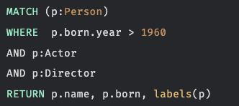

Testing labels or patterns?
Depending on your data model, it may be useful to test that a node has a label. This is particularly useful when a node may have multiple labels.

Slide 31

Discover relation type
This query retrieves all Movie nodes that are related to Tom Hanks. Each row returned is a movie title and the type of relationship that Tom Hanks has to that movie. We use the type() function to return the type of the relationship, r.

Slide 32
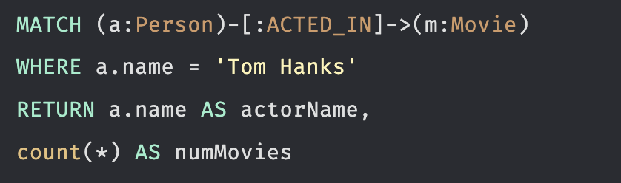
Counts
Cypher has a count() function that you can use to perform a count of nodes, relationships, paths, rows during query processing. When you aggregate in a Cypher statement, this means that the query must process all patterns in the MATCH clause to complete the aggregation to either return results or perform the next part of the query.

Slide 33
Counts and collect
Count works also by aggregating the elements of the previous variable in the returned list of elements
MATCH (p:Person {name: "Tom Hanks"})-[:ACTED_IN]->(m:Movie)<-[:ACTED_IN]-(s:Person)
WHERE s <> p
RETURN s.name AS co_actor, count(DISTINCT m) AS times_coacted
ORDER BY times_coacted DESC, co_actor;
You can also get a list of the counted elements with
MATCH (p:Person {name: "Tom Hanks"})-[:ACTED_IN]->(m:Movie)<-[:ACTED_IN]-(s:Person)
WHERE s <> p
RETURN s.name AS co_actor, count(DISTINCT m) AS times_coacted,
collect(DISTINCT m.title) AS shared_movies
ORDER BY times_coacted DESC, co_actor;

Slide 34
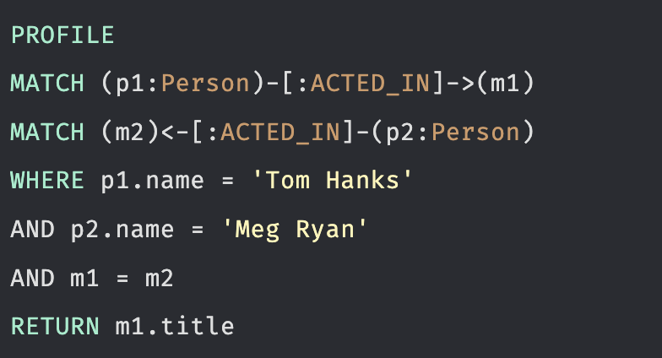
PROFILE
PROFILE statement allow to understand how a query starts and then how it is processed as the nodes are traversed in the graph.

Slide 35
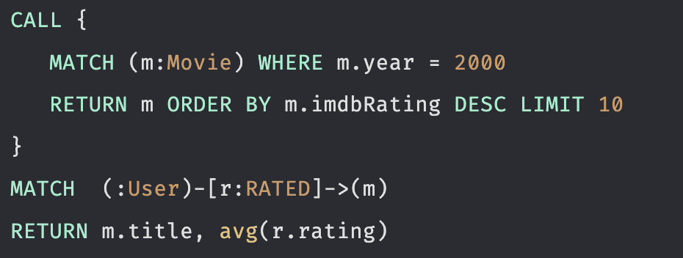
Subquery
When you execute a series of MATCH clauses, all nodes and relationships retrieved are in memory. If the memory requirements for a set of MATCH clauses exceed the VM configured, the query will fail.
In a CALL clause, you specify a query that can return data from the graph or derived from the graph. A set of nodes returned in the CALL clause can be used by the enclosing query.

Slide 36
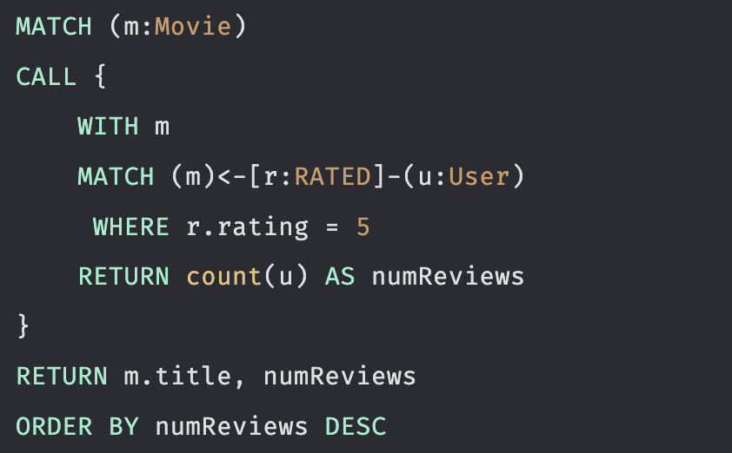
Passing variables into a subquery
The subquery can be executed after the initial query and the enclosing query passes a variable, m into the subquery.

Slide 37
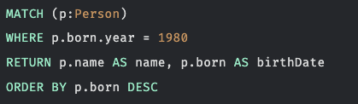
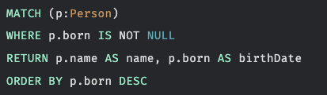
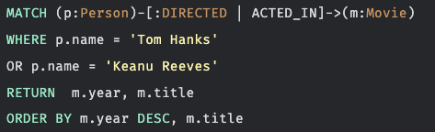
Ordering results
Whether you return results as nodes or as properties of nodes, you can specify a property value for the ordering

Slide 38
Create a new Database in neo4j Instance
To create a new database in a neo4j instance we need to:
Switch on system DB by the command :use system
Chech existing DBs by SHOW DATABASES;
Create a new db by CREATE DATABASE socialNet;
Switch on socialNet DB by the command :use socialNet

Slide 39
Neo4J Graph Data Science (GDS)
Neo4j Graph Data Science (GDS) is the analytics layer for running graph algorithms and ML-oriented workflows on top of graph data in Neo4j.
A typical workflow is: create a graph projection, run an algorithm, inspect the results, then write scores or communities back to the graph if needed.
GDS includes several families of algorithms, including community detection, centrality, similarity, pathfinding, and ML pipelines.
It is useful when you want to move from simple pattern matching to measuring structure, ranking nodes, and finding groups in a network.

Slide 40
Neo4J Graph Data Science (GDS)
First, project the relevant subgraph into the GDS catalog, because algorithms run on a projected graph rather than directly on the full transactional store.
For community detection, Louvain is a common choice because it groups densely connected nodes by optimizing modularity.
For importance ranking, PageRank measures transitive influence, while HITS distinguishes hubs from authorities in directed graphs.
Results can be streamed for analysis or mutated/written back as node properties for downstream dashboards, segmentation, recommendations, or fraud workflows

Slide 41
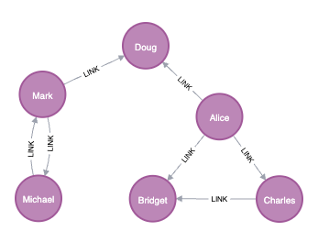
Community Detection
This examples shows hoe to run the Louvain community detection algorithm on a concrete graph.
We will do this on a small social network graph of a handful nodes connected in a particular pattern.

Slide 42
Community Detection
GDS algorithms run on an in-memory projected graph, not directly on the transactional graph.
MATCH (source:User)
OPTIONAL MATCH (source)-[r:LINK]->(target:User)
RETURN gds.graph.project(
'myGraph',
source,
target,
{
sourceNodeProperties: source { .seed },
targetNodeProperties: target { .seed },
relationshipProperties: r { .weight }
},
{ undirectedRelationshipTypes: ['*'] }
)

Slide 43
Community Detection
Now run Louvain, which is one of the standard community detection algorithms in Neo4j GDS and is used to assign community IDs to groups of densely connected nodes.
CALL gds.louvain.stream('myGraph')
YIELD nodeId, communityId, intermediateCommunityIds
RETURN gds.util.asNode(nodeId).name AS name, communityId
ORDER BY name ASC

Slide 44
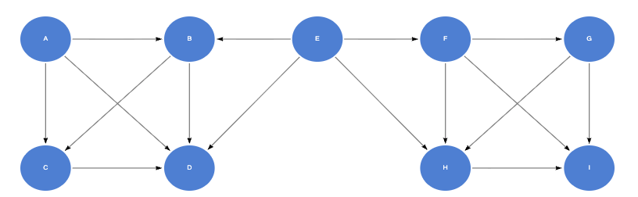
Hubs and Authorities
The Hyperlink-Induced Topic Search (HITS) is a link analysis algorithm that rates nodes based on two scores, a hub score and an authority score. The authority score estimates the importance of the node within the network. The hub score estimates the value of its relationships to other nodes.

Slide 45
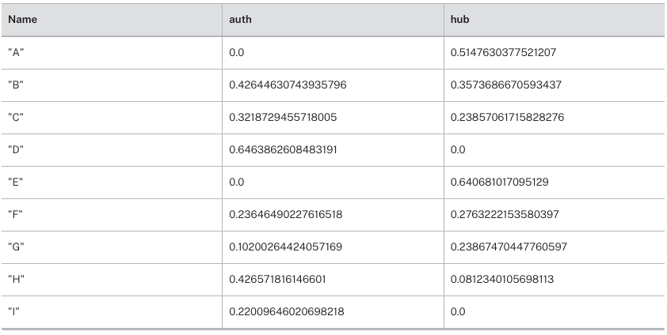
Hubs and Authorities
MATCH (source:Website)-[r:LINK]->(target:Website)
RETURN gds.graph.project(
'myGraph',
source,
target,
{},
{ inverseIndexedRelationshipTypes: ['*'] }
)
CALL gds.hits.stream('myGraph', {hitsIterations: 20})
YIELD nodeId, values
RETURN gds.util.asNode(nodeId).name AS Name,
values.auth AS auth, values.hub as hub
ORDER BY Name ASC

Slide 46
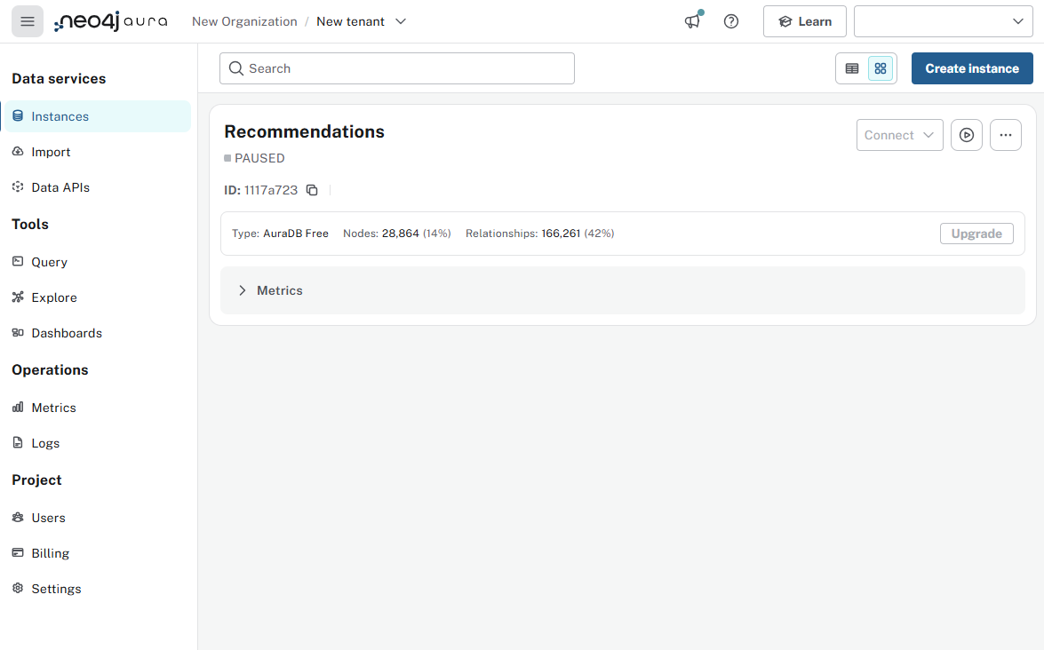
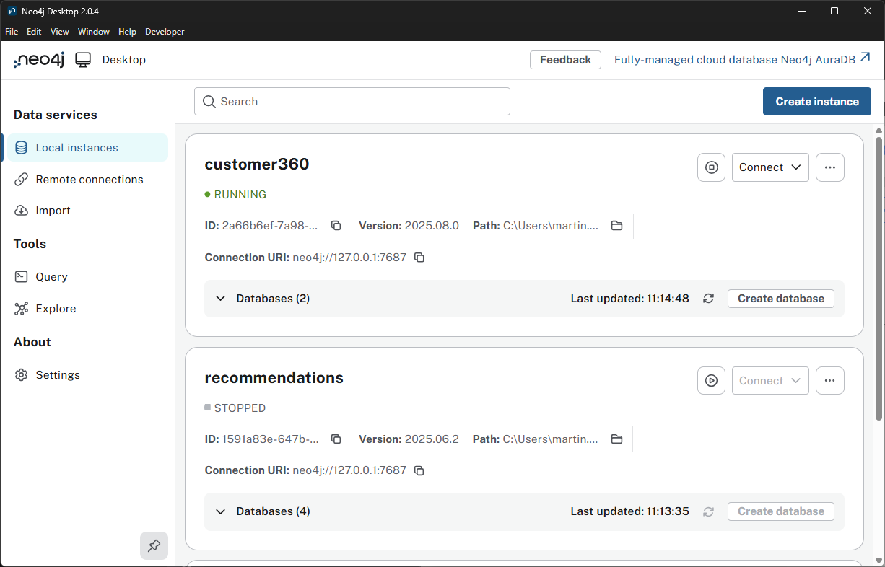
Noe4j deployments
There are many options to use Neo4j, including a fully hosted cloud solution (AuraDB), local installations, and Docker containers.
AuraDB is a fully managed cloud service that provides a Neo4j database as a service.
Neo4j provides a Desktop development tool that includes a local installation of Neo4j, a browser-based interface

Slide 47
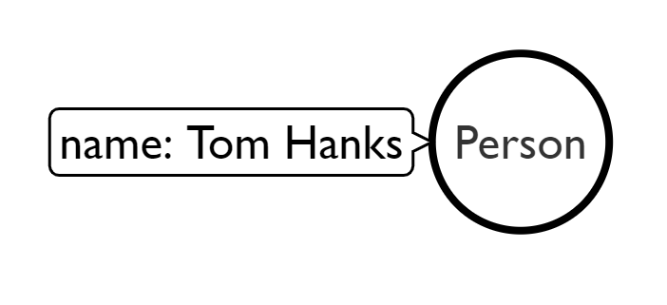
Use MATCH to retrieve nodes
//Match all nodes
MATCH (n)
RETURN n;

Slide 48
Use MATCH to retrieve nodes
//Match all nodes
MATCH (n)
RETURN n;
//Match all nodes with a Person label
MATCH (n:Person)
RETURN n;

Slide 49
Use MATCH to retrieve nodes
//Match all nodes
MATCH (n)
RETURN n;
//Match all nodes with a Person label
MATCH (n:Person)
RETURN n;
//Match all nodes with a Person label and property name is "Tom Hanks"
MATCH (n:Person {name: "Tom Hanks"})
RETURN n;

Slide 50
Use MATCH and properties to retrieve nodes
//Return nodes with label Person and name property is "Tom Hanks" - Inline
MATCH (p:Person {name: "Tom Hanks"}) //Only works with exact matches
RETURN p;

Slide 51
Use MATCH and properties to retrieve nodes
//Return nodes with label Person and name property is "Tom Hanks" - Inline
MATCH (p:Person {name: "Tom Hanks"}) //Only works with exact matches
RETURN p;
//Return nodes with label Person and name property equals "Tom Hanks"
MATCH (p:Person)
WHERE p.name = "Tom Hanks"
RETURN p;

Slide 52
Use MATCH and properties to retrieve nodes
//Return nodes with label Person and name property is "Tom Hanks" - Inline
MATCH (p:Person {name: "Tom Hanks"}) //Only works with exact matches
RETURN p;
//Return nodes with label Person and name property equals "Tom Hanks"
MATCH (p:Person)
WHERE p.name = "Tom Hanks"
RETURN p;
//Return nodes with label Movie, released property is between 1991 and 1999
MATCH (m:Movie)
WHERE m.released > 1990 AND m.released < 2000
RETURN m;

Slide 53
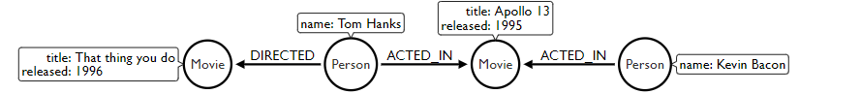
Extending the MATCH

Slide 54
Extending the MATCH
//Find all the movies Tom Hanks acted in
MATCH (:Person {name:"Tom Hanks"})-[:ACTED_IN]->(m:Movie)
RETURN m.title;

Slide 55
Extending the MATCH
//Find all the movies Tom Hanks acted in
MATCH (:Person {name:"Tom Hanks"})-[:ACTED_IN]->(m:Movie)
RETURN m.title;
//Find all the movies Tom Hanks directed and order by latest movie
MATCH (:Person {name:"Tom Hanks"})-[:DIRECTED]->(m:Movie)
RETURN m.title, m.released ORDER BY m.released DESC;

Slide 56
Extending the MATCH
//Find all the movies Tom Hanks acted in
MATCH (:Person {name:"Tom Hanks"})-[:ACTED_IN]->(m:Movie)
RETURN m.title;
//Find all the movies Tom Hanks directed and order by latest movie
MATCH (:Person {name:"Tom Hanks"})-[:DIRECTED]->(m:Movie)
RETURN m.title, m.released ORDER BY m.released DESC;
//Find all of the co-actors Tom Hanks have worked with
MATCH (:Person {name:"Tom Hanks"})-->(:Movie)<-[:ACTED_IN]-(coActor:Person)
RETURN coActor.name;

Slide 57
CREATE
//Create a person node called "Tom Hanks"
CREATE (p:Person {name:"Tom Hanks"});

Slide 58
CREATE
//Create a person node called "Tom Hanks"
CREATE (p:Person {name:"Tom Hanks"});
//Create an ACTED_IN relationship between "Tom Hanks" and "Apollo 13"
MATCH (p:Person {name:"Tom Hanks"}), (m:Movie {title:"Apollo 13"})
CREATE (p)-[:ACTED_IN]->(m);

Slide 59
CREATE
//Create a person node called "Tom Hanks"
CREATE (p:Person {name:"Tom Hanks"});
//Create an ACTED_IN relationship between "Tom Hanks" and "Apollo 13"
MATCH (p:Person {name:"Tom Hanks"}), (m:Movie {title:"Apollo 13"})
CREATE (p)-[:ACTED_IN]->(m);
//Create the pattern of "Tom Hanks" ACTED_IN "Apollo 13"
//This will create the entire pattern, nodes and all!
CREATE (:Person {name:"Tom Hanks")-[:ACTED_IN]->(:Movie {title:"Apollo 13});

Slide 60
1 Hops of distance
“Find the shortest path between two actors”
MATCH path = shortestPath(
(a:Person {name: 'Keanu Reeves'})-[*]-(b:Person {name: 'Tom Hanks'})
)
RETURN path;

Slide 61
2 Hops of distance
“Find the path between Tom Hanks and co-actors in 2 hops”
MATCH path =
(tom:Person {name: 'Tom Hanks'})-[:ACTED_IN]->(:Movie)<-[:ACTED_IN]-
(:Person)-[:ACTED_IN]->(:Movie)<-[:ACTED_IN]-(candidate:Person)
WHERE candidate <> tom
RETURN path
LIMIT 20;

